Slide 1
Analysis of The International Stroke Trial Database
Sandercock, P.A., Niewada, M., Członkowska, A. et al. The International Stroke Trial database. Trials 12, 101 (2011). https://doi.org/10.1186/1745-6215-12-101
Jessica Wise, Irene Hsueh, Naznin Sultana, Romie Velani & Jose Rivero

Slide 2
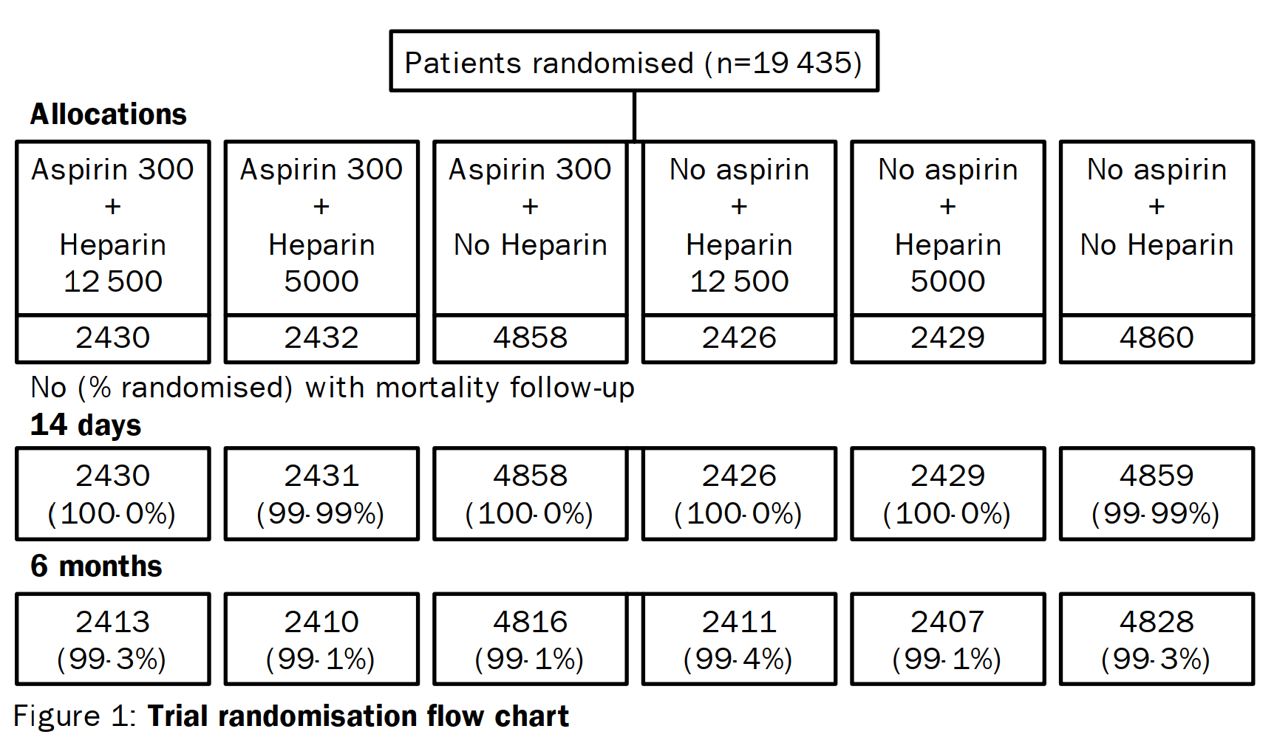
Background of the IST Dataset
Prospective, randomized controlled trial conducted between 1991-1996
Goal: to establish whether early administration of aspirin, subcutaneous heparin, both, or neither influenced clinical course of acute ischaemic stroke
2 × 3 factorial design = 6 treatments

Slide 3
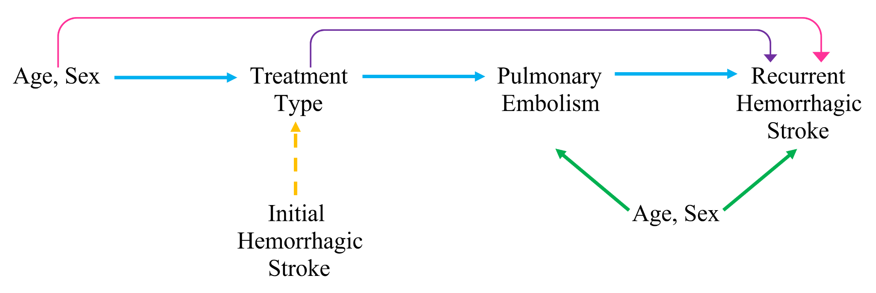
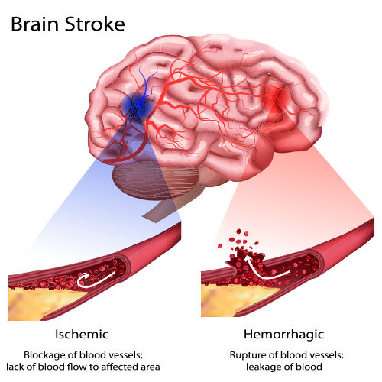
Research Questions
exposure = explanatory variable
outcome = response variable
confounder = variable that influences exposure and outcome
effect modifier = variable that changes the effect between exposure and outcome over its strata
mediator = variable that’s an effect of the exposure and a cause of the outcome so accounts for parts of total effect
Does treatment type have an effect on the proportion of recurrent hemorrhagic stroke after 14 days of follow-up?
Does treatment type have an effect on the proportion of recurrent hemorrhagic stroke after 14 days of follow-up, adjusting for potential confounders age and sex?
Is there interaction between treatment type and initial hemorrhagic stroke on recurrent hemorrhagic stroke?
Does treatment type have an effect on the proportion of recurrent hemorrhagic stroke through pulmonary embolism, adjusting for potential confounders age and sex?

Slide 4
Statistical Methods
Subset dataset of interest
Treatment Aspirin 300 mg & No Heparin 4,853 subjects
Placebo No Aspirin & No Heparin 4,852 subjects
Logistic regression adjusting for confounders age and sex
Assess interaction between treatment and initial hemorrhagic stroke
Assess mediation through pulmonary embolism, adjusting for confounders age and sex
3 lost to follow-up
2 unknown
4 lost to follow-up
4 unknown
TOTAL
7 lost to follow-up
6 unknown
9,705 subjects

Slide 5
Baseline Demographics and Clinical Characteristics
Table 1.1 |  | Treatment (aspirin 300 mg & no heparin) (n=4,858) | Placebo (no aspirin & no heparin) (n=4,860) | Total (n=9,718)
Sex (n,%) | Female | 2,309 (47.53%) | 2,250 (46.30%) | 4,559 (46.91%)
 | Male | 2,549 (52.47%) | 2,610 (53.70%) | 5,159 (53.09%)
Age (mean, SD) |  | 71.77 (11.63) | 71.61 (11.72) | 71.69 (11.68)
Conscious State (n,%) | Alert | 3,681 (75.77%) | 3,781 (77.80%) | 7,462 (76.79%)
 | Drowsy | 1,109 (22.83%) | 1,019 (20.97%) | 2,128 (21.90%)
 | Unconscious | 68 (1.40%) | 60 (1.23%) | 128 (1.32%)
Visible Infarct (n,%) | Yes | 1,611 (33.16%) | 1,631 (33.56%) | 3,242 (33.36%)
 | No | 3,247 (66.84%) | 3,229 (66.44%) | 6476 (66.64%)
SBP (mean, SD) |  | 159.47 (27.52) | 160.08 (27.90) | 159.91 (27.71)
Notes:
Baseline characteristics are balanced because this is a gold-standard randomized, controlled trial!

Slide 6
Baseline Demographics and Clinical Characteristics Cont.
Table 1.2 |  | Treatment (aspirin 300 mg & no heparin) (n=4,858) | Placebo (no aspirin & no heparin) (n=4,860) | Total (n=9,718)
Face Deficit (n,%) | Yes | 3,537 (72.81%) | 3,517 (72.37%) | 7,054 (72.59%)
 | No | 1,256 (25.85%) | 1,269 (26.11%) | 2,525 (25.98%)
 | Can’t Assess | 65 (1.34%) | 74 (1.52%) | 139 (1.43%)
Arm/Hand Deficit (n,%) | Yes | 4,155 (85.53%) | 4,157 (85.53%) | 8,312 (85.53%)
 | No | 675 (13.89%) | 666 (13.70%) | 1,341 (13.80%)
 | Can’t Assess | 28 (0.58%) | 37 (0.76%) | 65 (0.67%)
Leg/Foot Deficit (n,%) | Yes | 3,639 (74.91%) | 3,665 (75.41%) | 7,304 (75.16%)
 | No | 1,150 (23.67%) | 1,133 (23.31%) | 2,283 (23.49%)
 | Can’t Assess | 69 (1.42%) | 62 (1.28%) | 131 (1.35%)

Slide 7
Baseline Demographics and Clinical Characteristics Cont.
Table 1.2 |  | Treatment (aspirin 300 mg & no heparin) (n=4,858) | Placebo (no aspirin & no heparin) (n=4,860) | Total (n=9,718)
Dysphagia (n,%) | Yes | 2,156 (44.38%) | 2,124 (43.70%) | 4,280 (44.04%)
 | No | 2,561 (52.72%) | 2,577 (53.02%) | 5,138 (52.87%)
 | Can’t Assess | 141 (2.90%) | 159 (3.27%) | 300 (3.09%)
Hemianopia(n,%) | Yes | 792 (16.30%) | 747 (15.37%) | 1,539 (15.84%)
 | No | 3,048 (62.74%) | 3,120 (64.20%) | 6,168 (63.47%)
 | Can’t Assess | 1,018 (20.96%) | 993 (20.43%) | 2,011 (20.69%)
Visuospatial Disorder (n,%) | Yes | 836 (17.21%) | 764 (15.72%) | 1,600 (16.46%)
 | No | 3,161 (65.07%) | 3,214 (66.13%) | 6,375 (65.60%)
 | Can’t Assess | 861 (17.72%) | 882 (18.15%) | 1,743 (17.94%)
Brainstem/Cerebellar Signs (n,%) | Yes | 506 (10.42%) | 546 (11.23%) | 1,052 (10.83%)
 | No | 3,944 (81.19%) | 3,936 (80.99%) | 7,880 (81.09%)
 | Can’t Assess | 408 (8.40%) | 378 (7.78%) | 786 (8.09%)

Slide 8
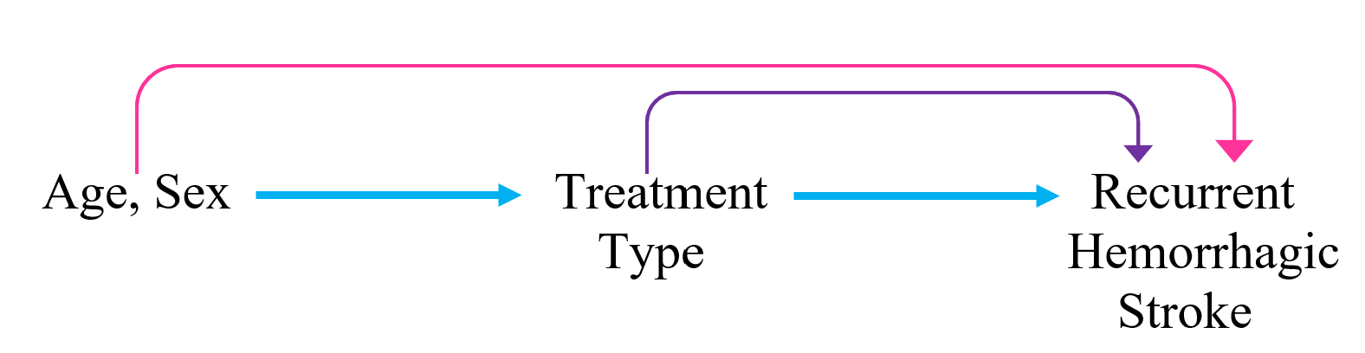
Crude and Adjusted
Analysis Results
Table 2.1 - Crude logistic regression results
Effect | Parameter Estimate | Odds Ratio | 95% Odds Ratio Confidence Limits | p-value
Treatment | 0.4364 | 1.5471 | 0.724, 3.306 | 0.2601
Table 2.2 - Adjusted logistic regression results
Effect | Parameter Estimate | Odds Ratio | 95% Odds Ratio Confidence Limits | p-value
Treatment | 0.4436 | 1.5583 | 0.729, 3.331 | 0.2525
Sex | 0.1809 | 1.1983 | 0.544, 2.590 | 0.6455
Age | -0.0282 | 0.9722 | 0.945, 1.001 | 0.0549
Notes:
In the crude logistic regression analysis, the effect of treatment was not statistically significant. The beta estimate was 0.4346 and exponentiating that gave an odds ratio of 1.5471 with a 95% confidence interval from 0.724 to 3.306, which is very wide. The p-value for this association was 0.2601, which is quite high.
In the logistic regression analysis adjusting for age and sex, the effect of treatment was also not statistically significant. The beta estimate was 0.4436 and exponentiating that gave an odds ratio of 1.5583 with a 95% confidence interval of 0.729 to 3.331, which is very wide. The p-value for this association was 0.2525, which is quite high. The odds ratio for sex was extremely insignificant, with a p-value of 0.6455, and the odds ratio for age was just barely insignificant, with a p-value of 0.0549.
We can see that adding age and sex to the model created only a miniscule change in the beta estimate and OR for the effect of treatment on recurrent hemmorhagic stroke.

Slide 9
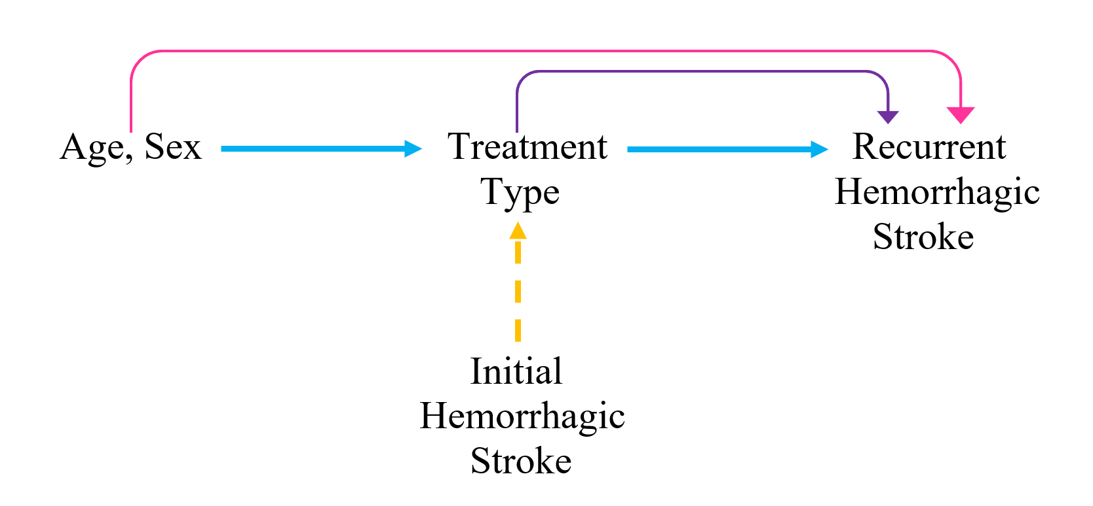
Effect Modification/
Interaction Analysis
Table 3 - Adjusted logistic regression with interaction results
Effect | Parameter Estimate | Odds Ratio | 95% Odds Ratio Confidence Limits | p-value
Treatment | 0.3290 | - | - | 0.4795
Initial Hemorrhagic Stroke | 2.5992 | - | - | 0.0001
Trt * initial_hemstroke | 0.3600 | - | - | 0.6742
Aspirin vs Placebo, NO initial_hemstroke | - | 1.390 | 0.558, 3.459 | -
Aspirin vs Placebo, YES initial_hemstroke | - | 1.992 | 0.487, 8.150 | -
Sex | 0.1706 | 1.186 | 0.546, 2.578 | 0.6666
Age | -0.0322 | 0.968 | 0.940, 0.998 | 0.0342

Slide 10
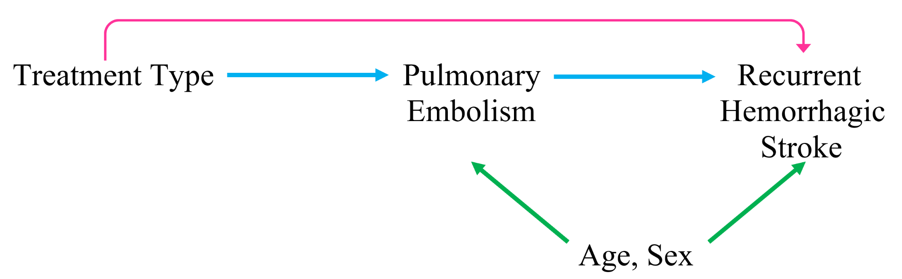
Mediation Analysis
Table 4 - Causal mediation analysis results
 | Parameter Estimate | 95% CI Lower | 95% CI Upper | p-value
Natural Direct Effect | 0.0013633 | -0.0007973 | 0.00 | 0.23
Natural Indirect Effect | -0.0000781 | -0.0004260 | 0.00 | 0.25
Total Effect | 0.0013131 | -0.0009073 | 0.00 | 0.25
Proportion Mediated | -0.0211428 | -0.6576451 | 0.23 | 0.45
Indirect effect and total effect have different signs!
Cannot interpret proportion mediated

Slide 11

Conclusions
Does treatment type have an effect on the proportion of recurrent hemorrhagic stroke after 14 days of follow-up?
Does treatment type have an effect on the proportion of recurrent hemorrhagic stroke after 14 days of follow-up, adjusting for potential confounders age and sex?
Is there interaction between treatment type and initial hemorrhagic stroke on recurrent hemorrhagic stroke?
Does treatment type have an effect on the proportion of recurrent hemorrhagic stroke through pulmonary embolism, adjusting for potential confounders age and sex?

Slide 12
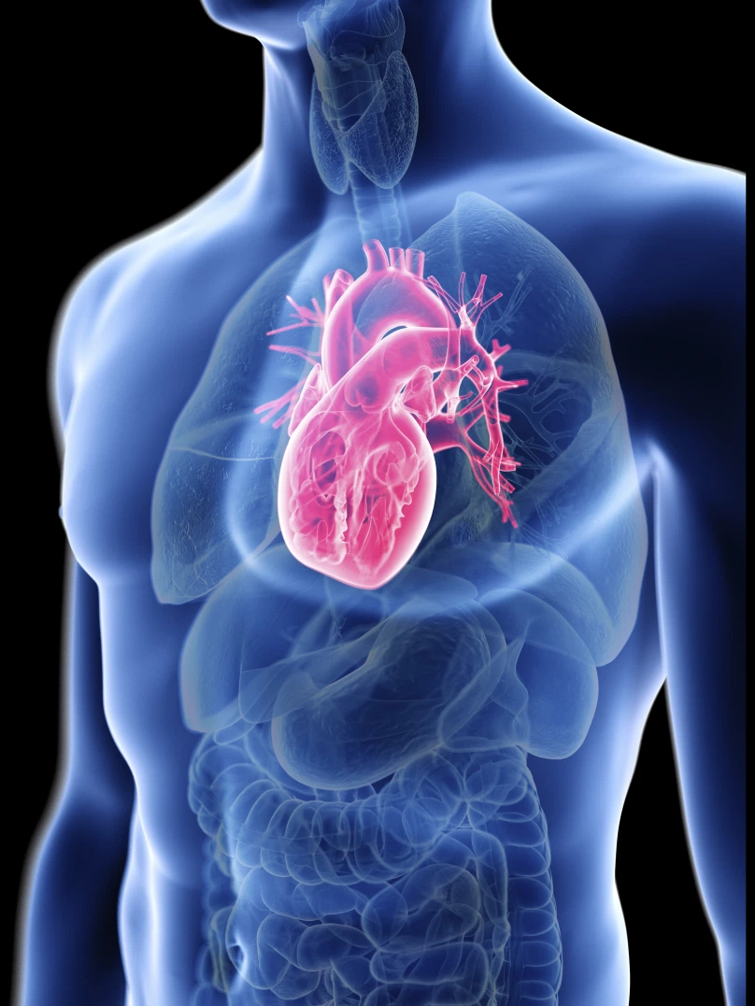

Questions?

